Slide 1
Systematic Approach to solving ML problems
Preethi Dixit, Shashi Roshan, Zubin Sethna

Slide 2
Who we are? Why we are here?

Slide 3
What’s your expectation out of this workshop?

Slide 4
ML

Slide 5
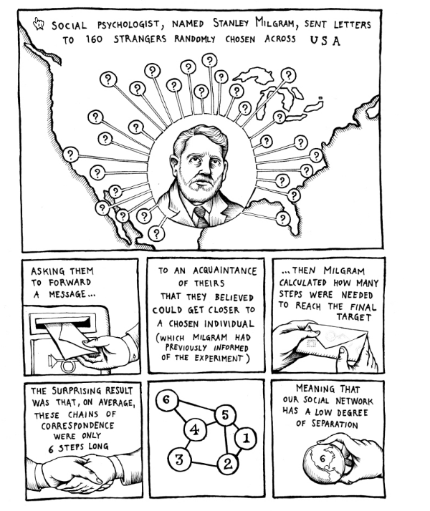

Slide 6
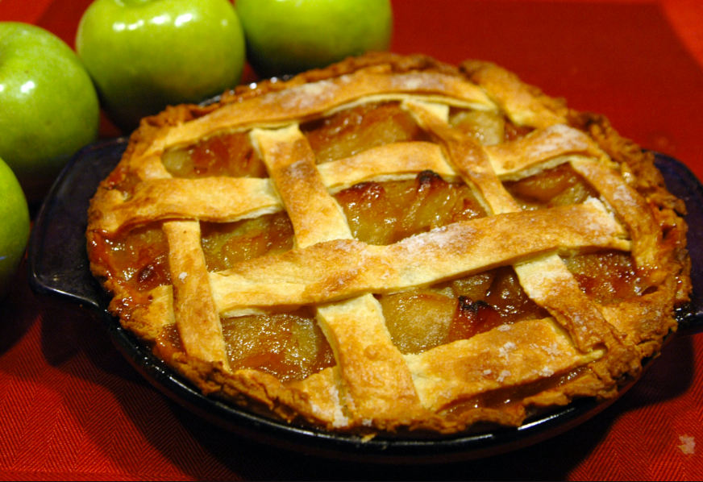

Slide 7
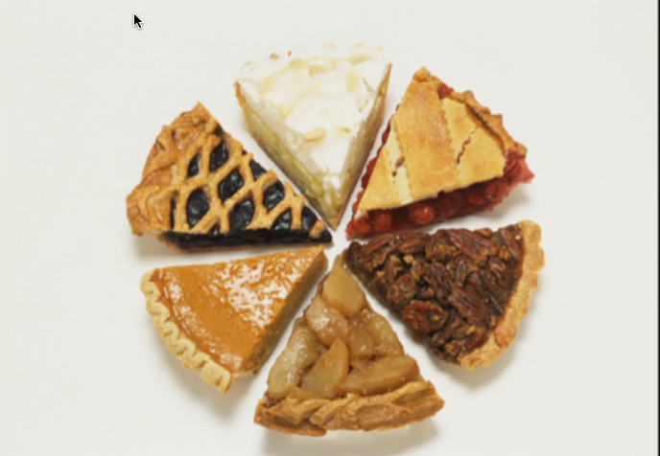

Slide 8
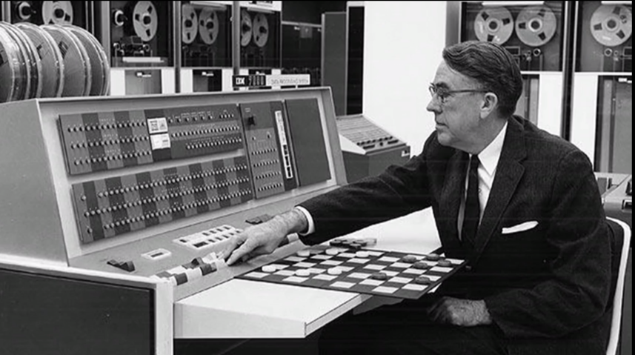

Slide 9


Slide 10
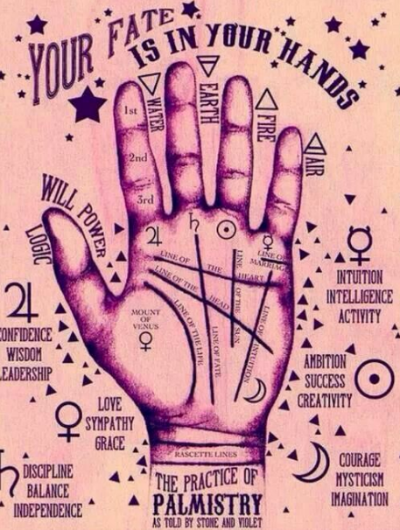

Slide 11
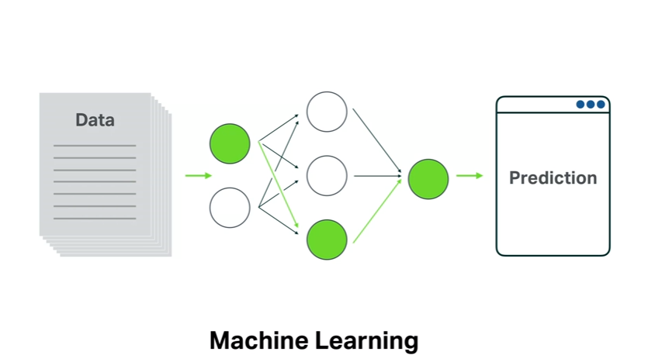

Slide 12
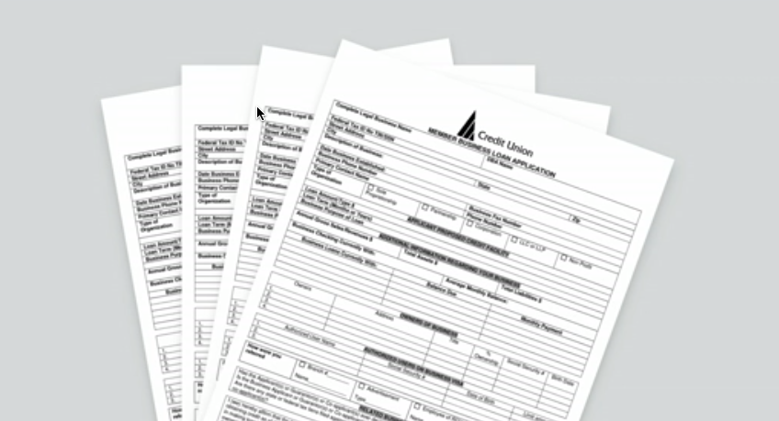

Slide 13
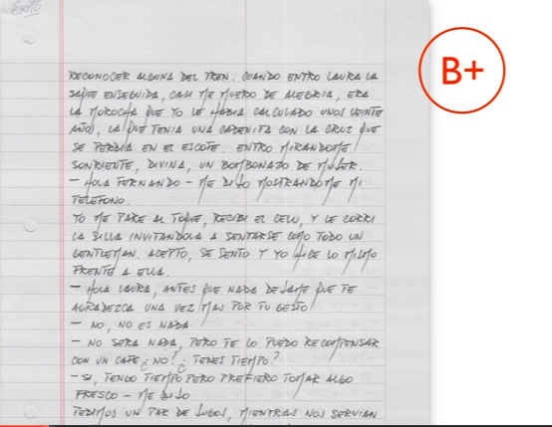

Slide 14
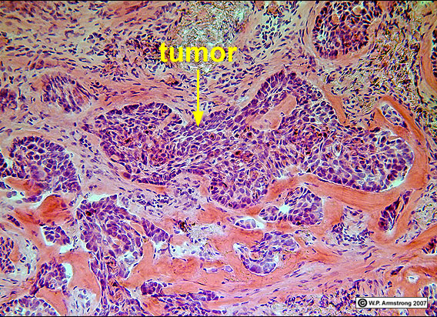

Slide 15


Slide 16
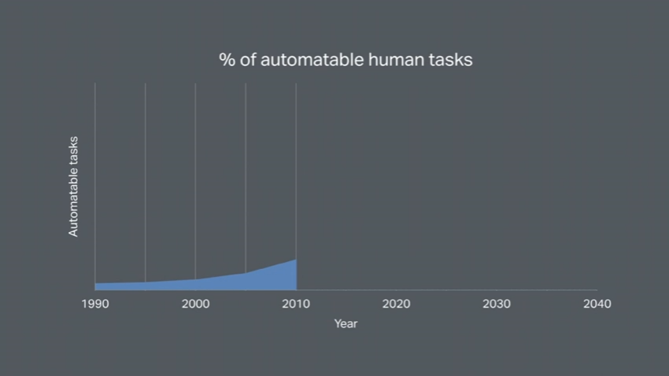

Slide 17
Workshop on ML
Understanding what ML
How to think about the problem, model and solution
ML Algorithms
Use of standard libraries to approach a ML problem
Hands on!

Slide 18


What is Machine Learning ?

Slide 19
Fields Involved
Artificial Intelligence
Algorithms
Applied Statistics

Slide 20
Types
Supervised
Un-supervised
Reinforcement

Slide 22
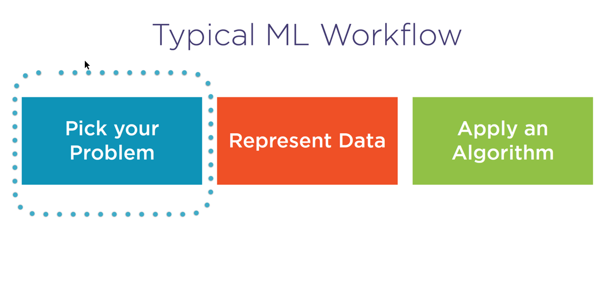

Slide 23
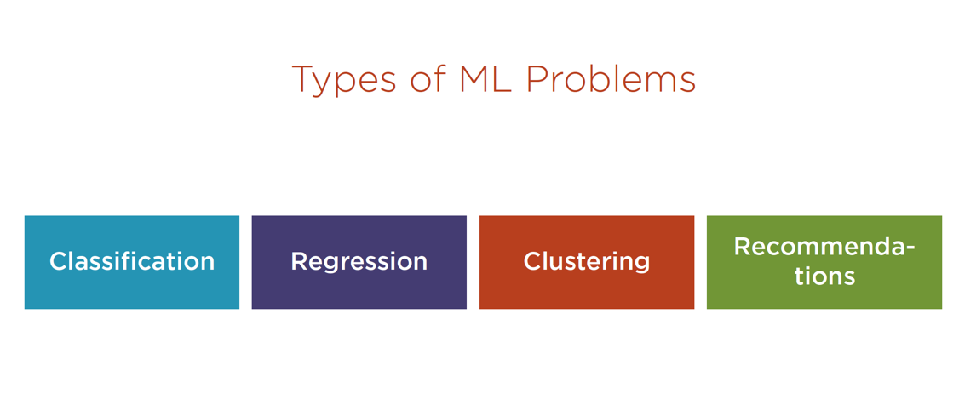

Slide 24
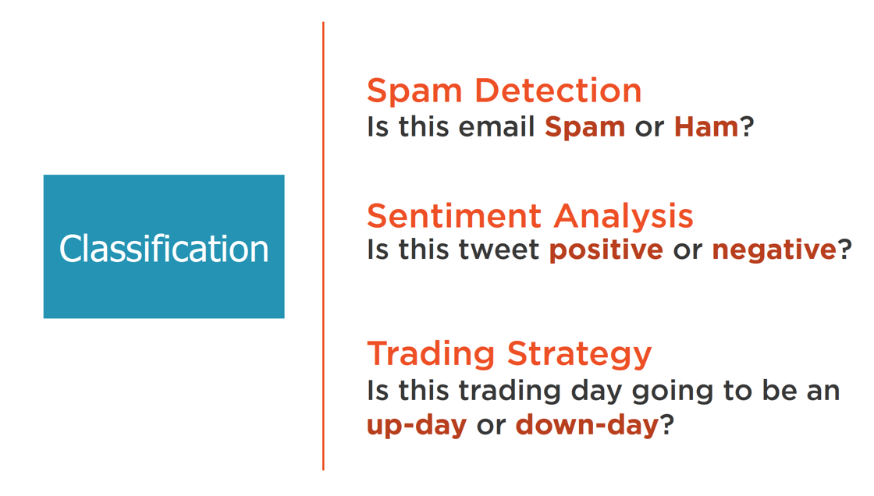

Slide 25
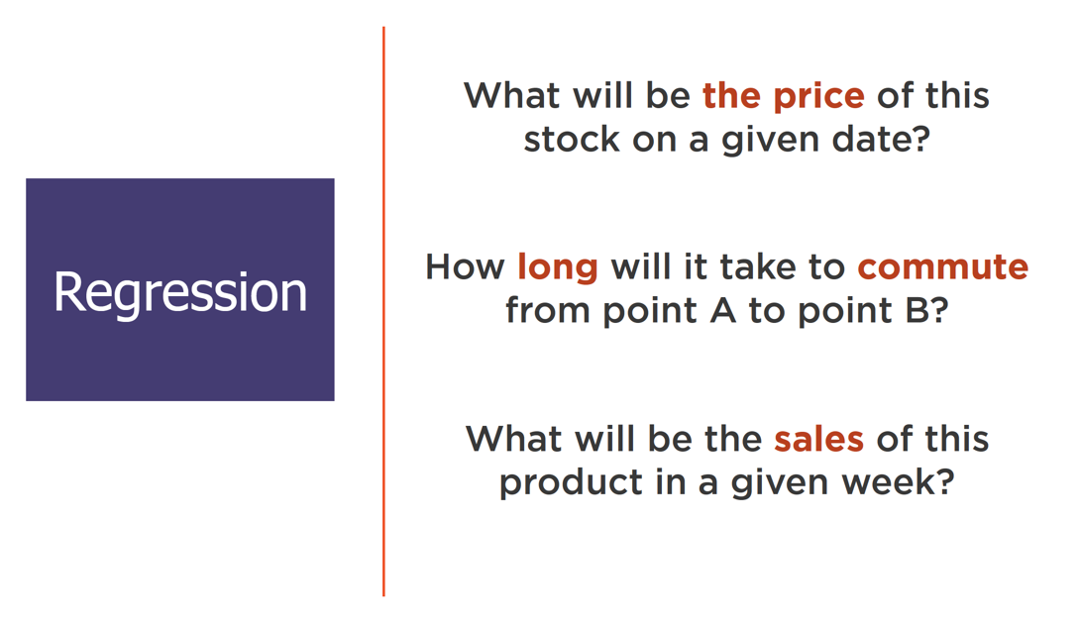

Slide 26
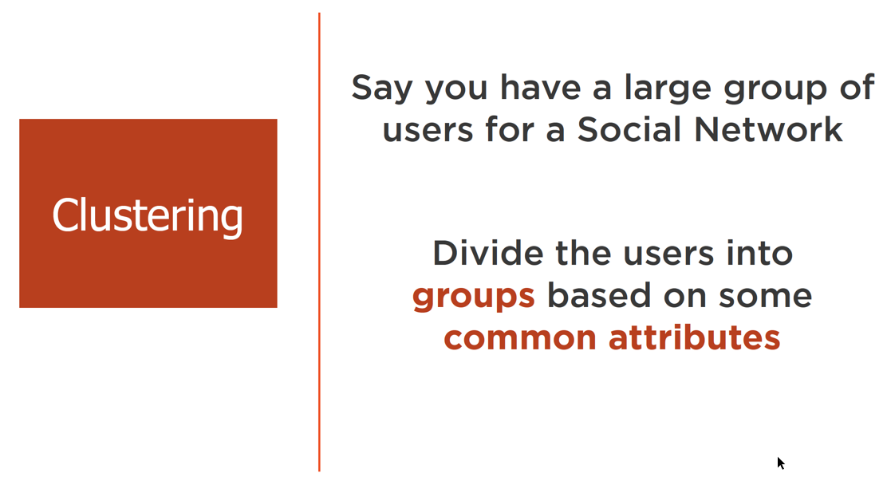

Slide 27
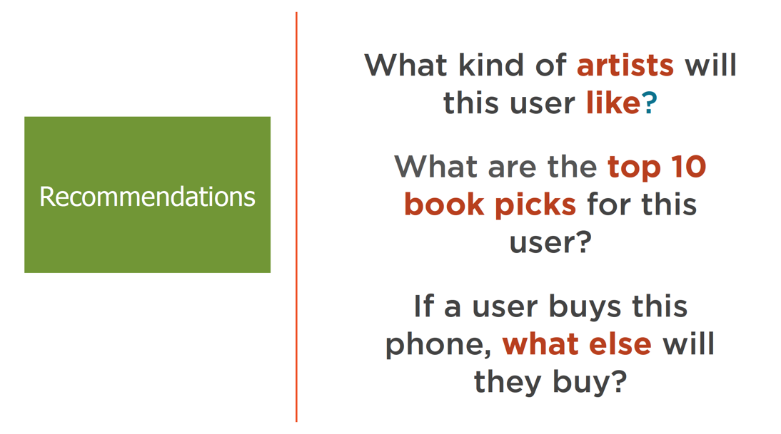

Slide 28
Quiz Time
Identify if it is Supervised/Unsupervised/Reinforcement –
Classification
Clustering
Regression
Deep learning

Slide 29
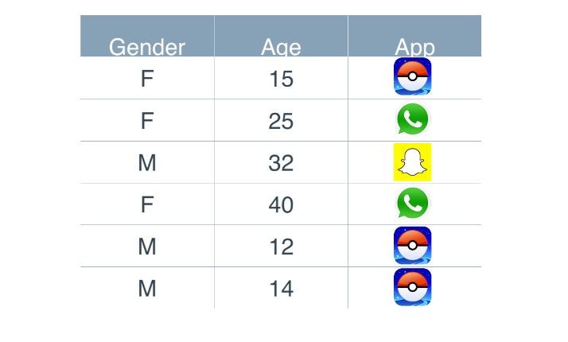
Example – App Recommendation

Slide 30
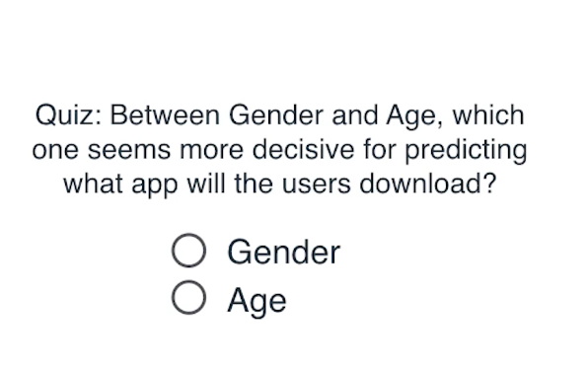
Time for Quiz!

Slide 31
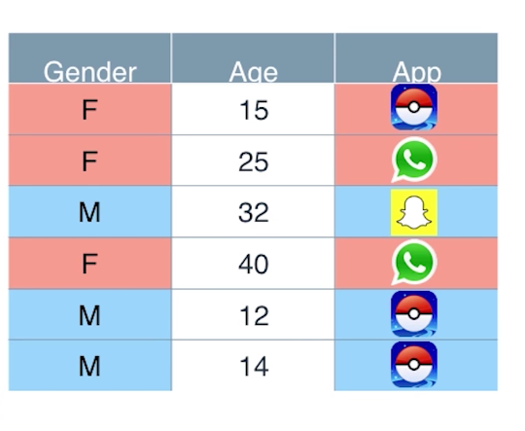
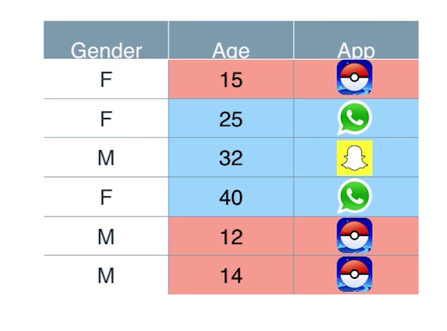
Gender Based
Age Based

Slide 32
Answer
Feature that helped us decide the recommendation is AGE!
We are always looking for features in our data!

Slide 33
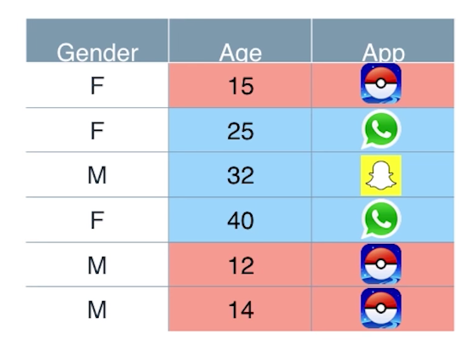
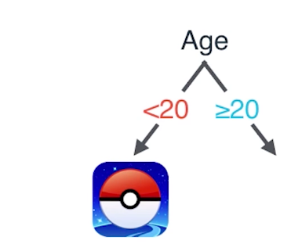
App Recommendation

Slide 34
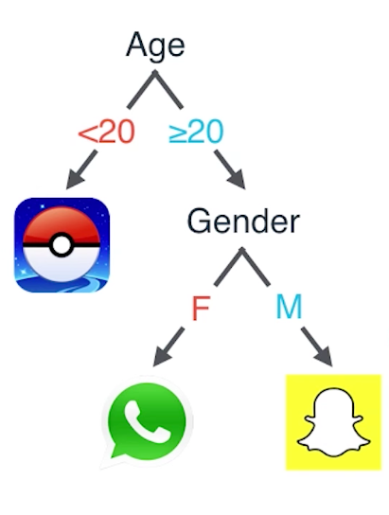
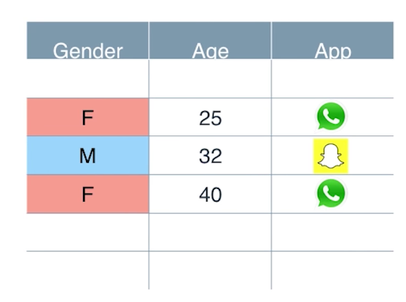
App Recommendation

Slide 35
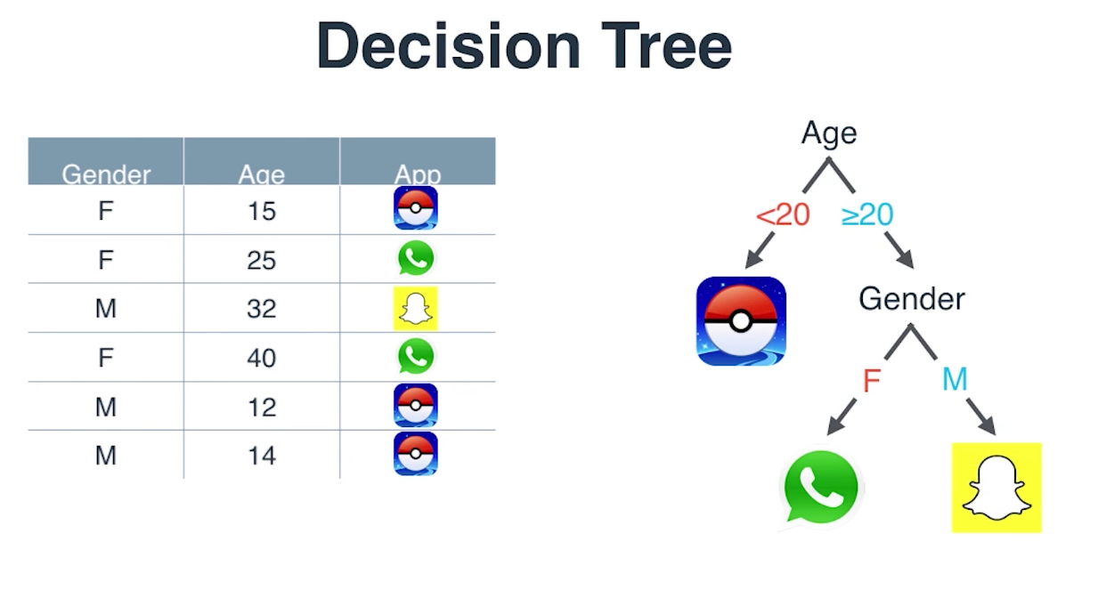

Slide 36
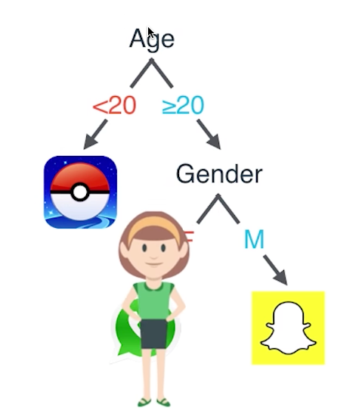
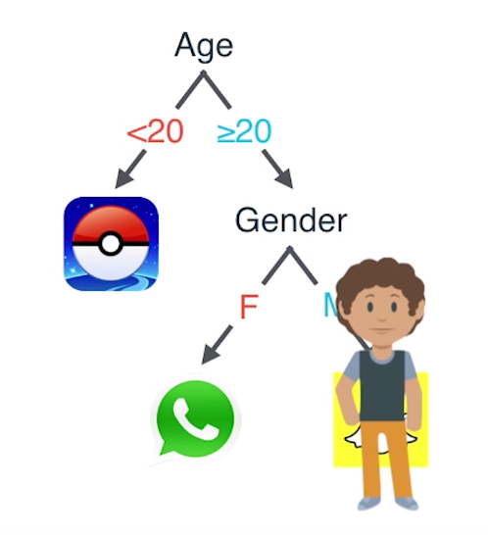
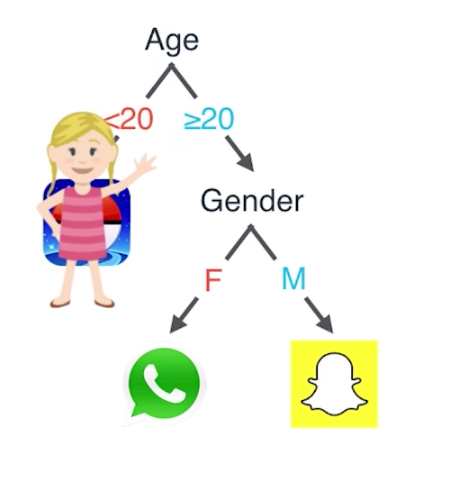
What did we achieve ?
For a new user, recommendation is given based on decision tree.

Slide 37
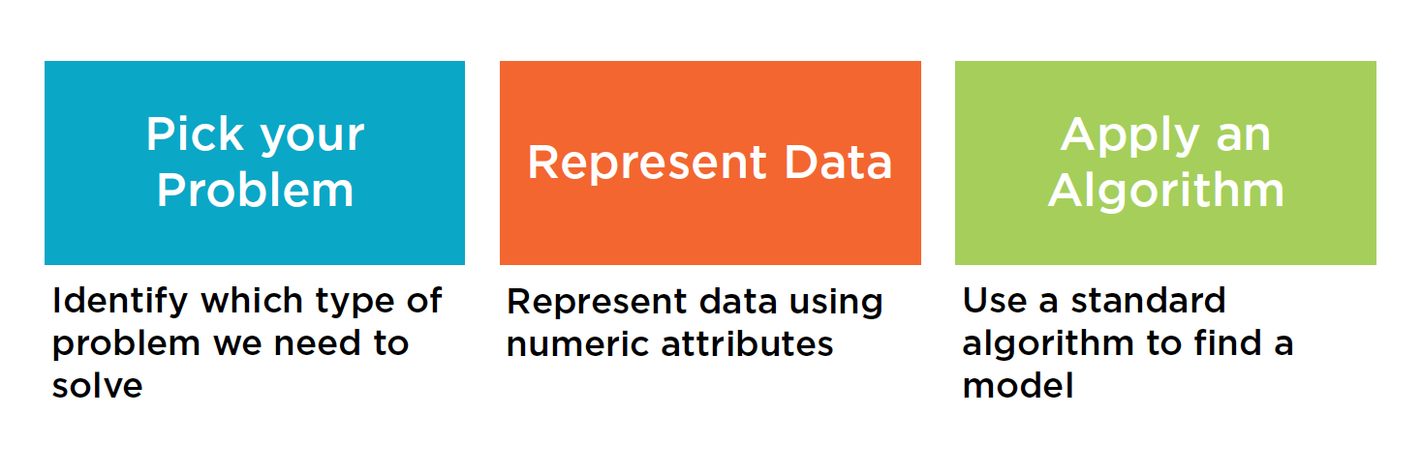
What did we just do now ??
We applied ML to solve a recommendation
problem

Slide 38

Points to remember
Model
Feedback Loop

Slide 39
Time for Hands on!!
Install Anaconda

Slide 40
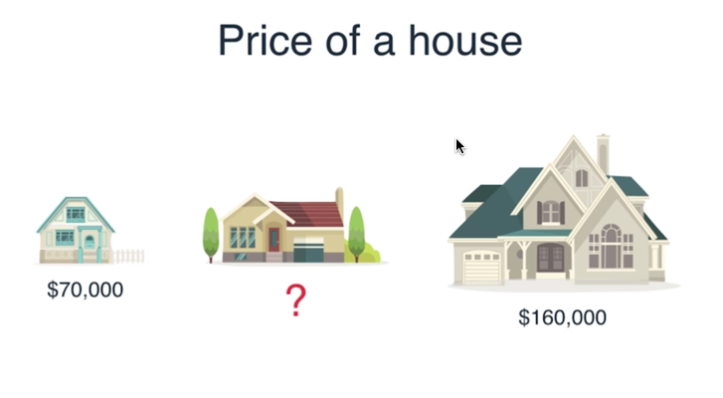

House Price Estimation

Slide 41
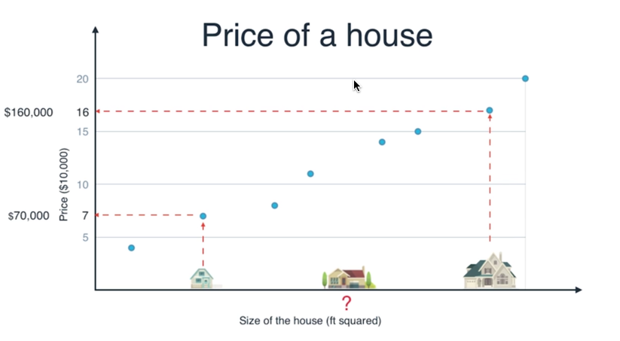
House Price Estimation

Slide 42
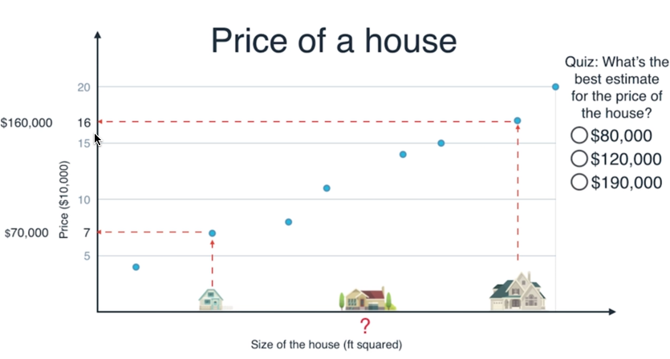

Slide 43
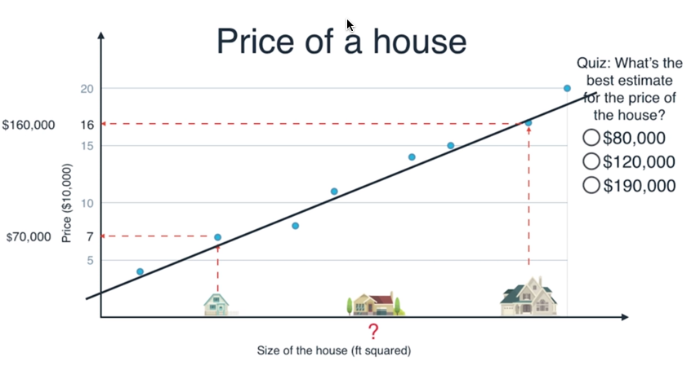

Slide 45
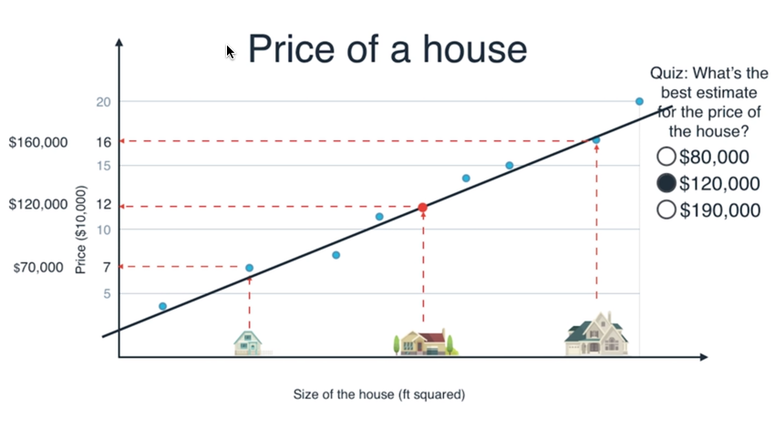
Linear Regression

Slide 46
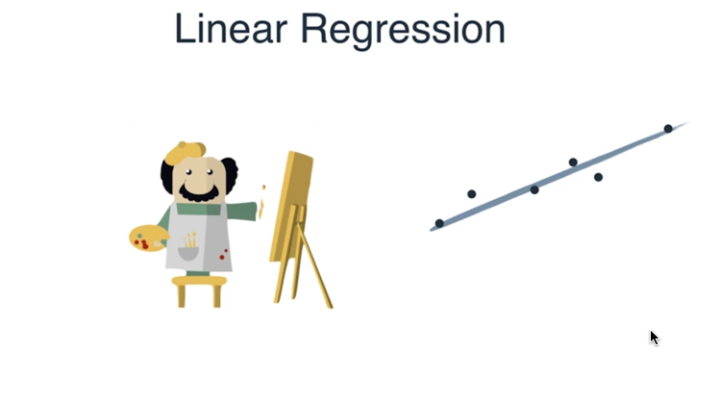

Slide 47
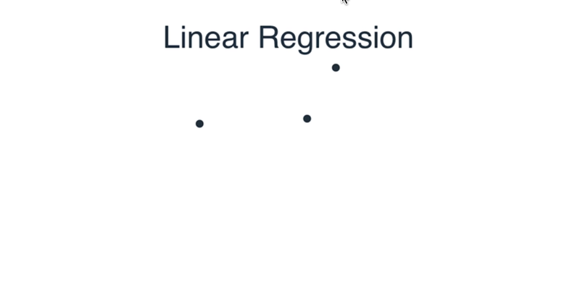

Slide 48
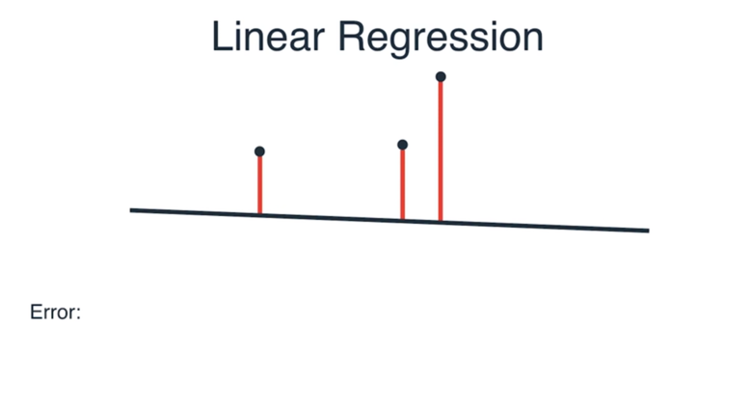

Slide 49
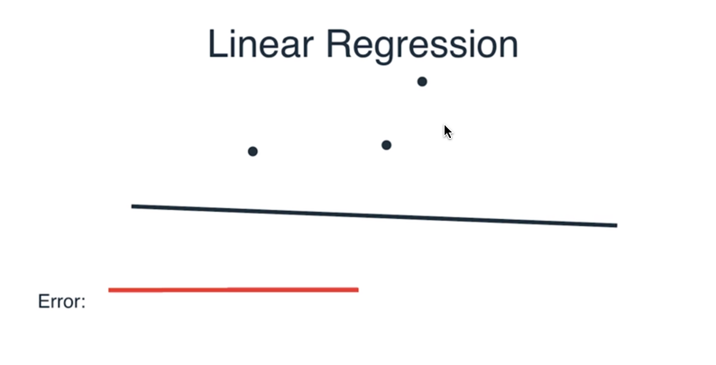

Slide 50
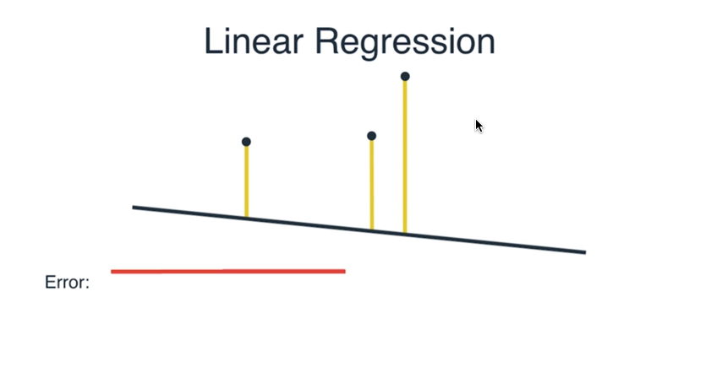

Slide 51
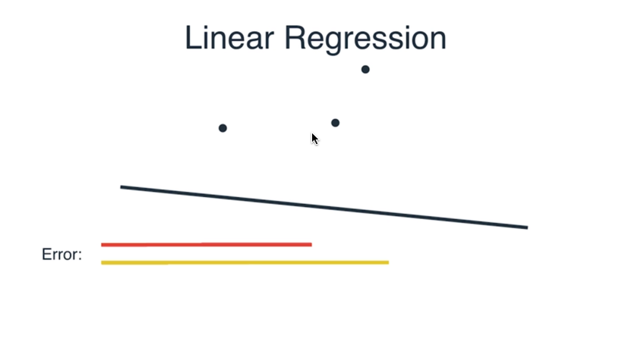

Slide 52
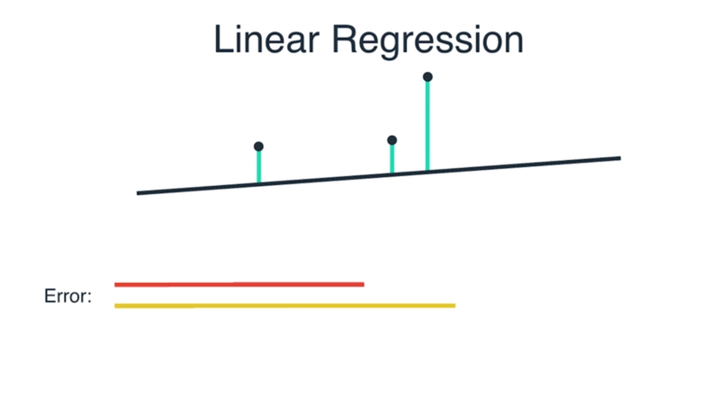

Slide 53
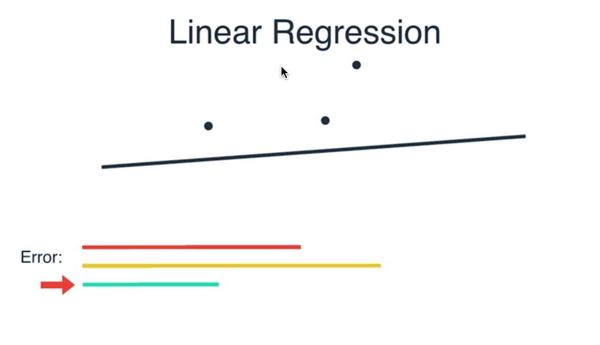

Slide 54
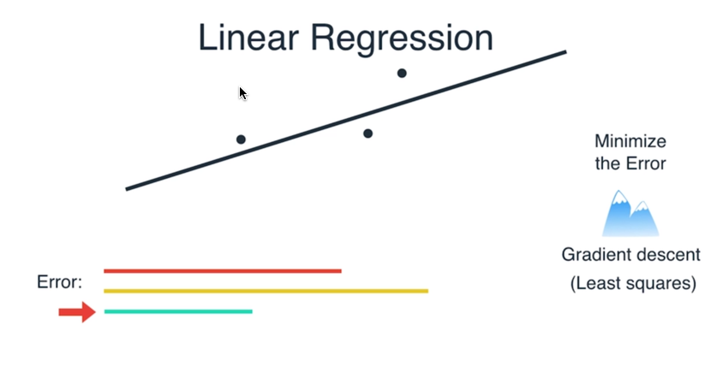

Slide 55
Time for Hands on!!

